Slide 1
Experimental Solid Rocket Nozzle
By: Cameron Flannery, Harrison Box, Nico Fassardi

Slide 2
Agenda
Vehicle Overview
Nozzle Design Overview
Thermal
Fluid Flow

Slide 3
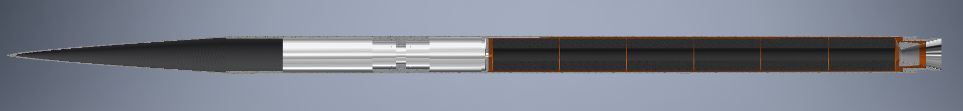
Vehicle Overview (Major Components)
16’
7’8”
Nosecone
Recovery System
BATES grains
Avi-bay
Section Adapter
Ablative Nozzle
General
2 piece aluminum airframe
Aluminum section adapter
¾ power series nosecone
Carbon fiber
Note: Fins still under design review
Propulsion
Q-Class Motor
APCP (Aluminum Fuel/Ammonium Perchlorate Oxidizer)
Ablatively cooled nozzle
BATES grains

Slide 4
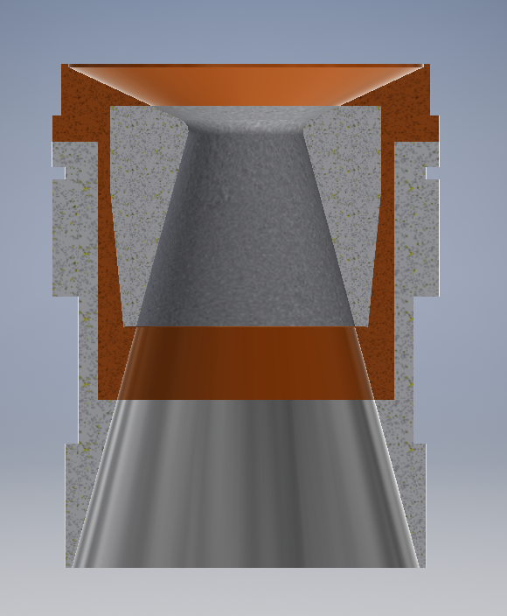
Nozzle Overview
Nozzle for High-powered Experimental Rockets
Phenolic
(2-pieces)
Graphite Throat
Aluminum Retainer
Aluminum Carrier
Aluminum Skirt

Slide 5
Nozzle Design – Thermal

Slide 6
Nozzle Design – Fluid Flow

Slide 7
Risks

Slide 8
Q & A

Slide 9
BACKUP SLIDES

